Slide 1
TEAM NAME : VVT DAZZLERS
TEAM NUMBER : 30

Slide 2
ACADEMIC MENTOR : Er SATHISH R M.E.,(PhD)
INDUSTRY MENTOR :

Slide 3
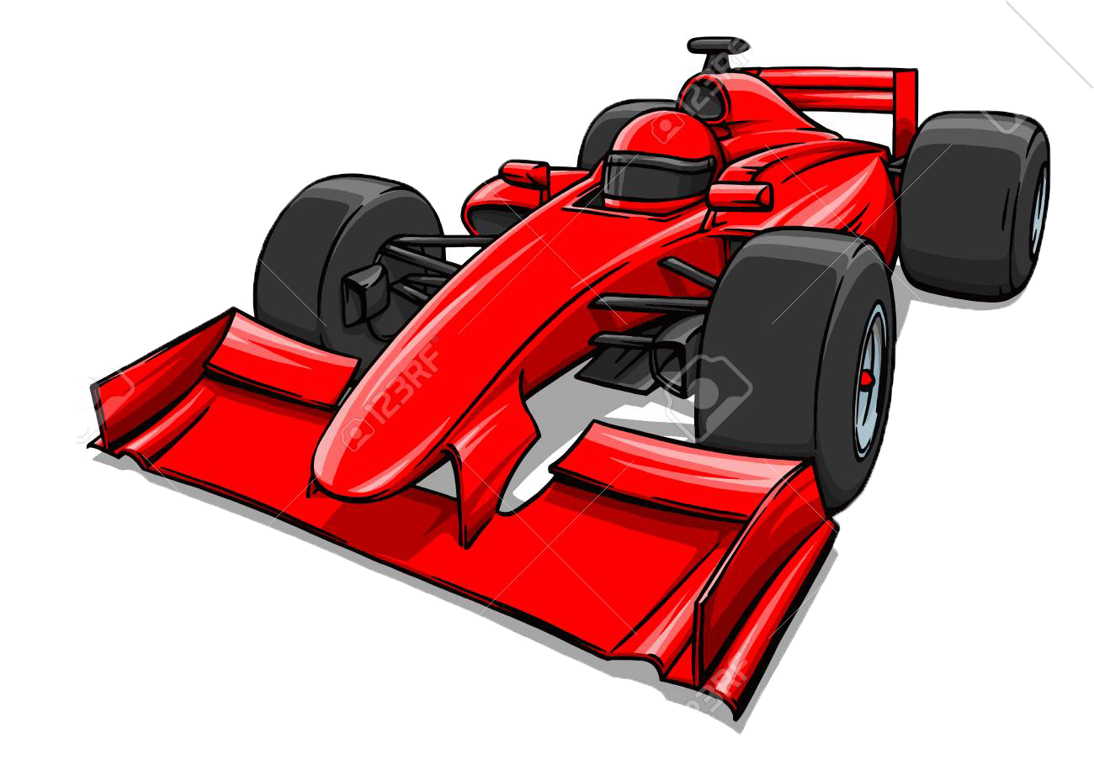
F1 DASH

Slide 4
ABSTRACT
THE TITLE OF OUR PROJECT IS F1 DASH. IT IS A PYTHON PROGRAM USED TO CREATE A RACING GAME. IT IS A STRATEGY BASED GAME , THE MAIN OBJECTIVE IS TO COMPLETE A TASKWITHIN A PARTICULAR TIME. IT CONSIST OF TWO LEVELS AND HAS ONLY ONE PLAYER. THE PLAYER HAS TO PASS THE COMPLEX PATH CREATED BY OBSTACLE BLOCK. AFTER COMPLETING THE TASK, THE PLAYER MOVES TO THE NEXT LEVEL, WHERE HE HAD TO PASS THE MORE COMPLEX PATH WHEN COMPARED TO PREVIOUS LEVEL. AFTER COMPLETING BOTH THE TASK THE PLAYER IS ANNOUNCED AS THE WINNER. THIS IS THE END OF THE GAME.

Slide 5
MODULES
TIMER : WITHIN A PARTICULAR TIME, THE TASK SHOULD BE COMPLETED.
LEVELS : THE GAME CONSISTS OF TWO LEVELS.
CAR : WE HAVE USED AN ATTRACTIVE F1 SPORTS CAR.
BLOCKS : THE PLAYER MUST PASS THROUGH THE GABS BETWEEN BLOCKS
TO SUCCEED.

Slide 6
REQUIREMENTS
OS : WINDOWS, LINUX, MAC (ANY)
SOFTWARE : THONNY(ANYOTHER IDE),
PYGAME
LANGUAGE : PYTHON

Slide 7
MODEL ARCHITECTURE
RUN THE CODE.
FOLLOW THE INSTRUCTION TO BEGIN.
FINISH LEVEL 1 TO ENTER LEVEL 2.
FINISH LEVEL 2 THE YOU’RE THE WINNER.

Slide 8
PYGAME

Slide 9
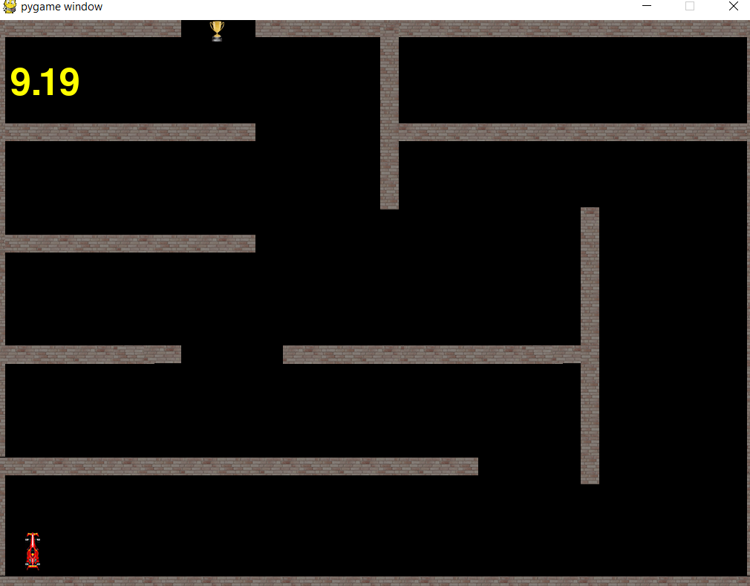
LEVEL 1

Slide 10
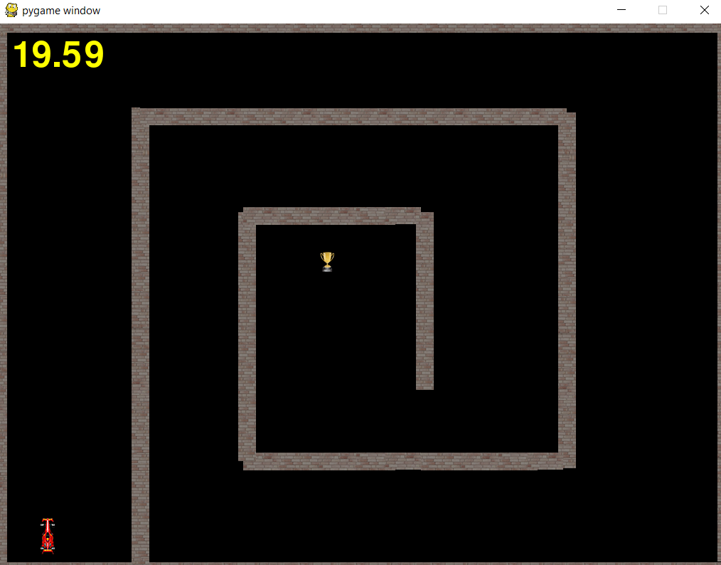
LEVEL 2

Slide 11


